Slide 1
Welcome To Merrill
Middle
School!
This Photo by Unknown author is licensed under CC BY-NC-ND.

Slide 2
Meet Mrs. Panek!
Your School Principal

Slide 3
School Colors
are...
Navy Blue and White

Slide 4
Our School Mascot is………..
The Mustang!!!

Slide 5
Merrill is an IB School!
IB Stands For………
International Baccalaurette
This Photo by Unknown Author is licensed under CC BY-SA

Slide 6
Inquirers
Knowledgeable
Thinkers
Communicators
Principled
Open Minded
Caring
Risk-Takers
Balanced
Reflective
Merrill IB Learners are…..

Slide 7
Above all else, Merrill Students are:
C.aring
P. rincipled
R.eflective

Slide 8
CPR is practiced everywhere! In: Classrooms Hallways Main Office Cafeteria Outside

Slide 9
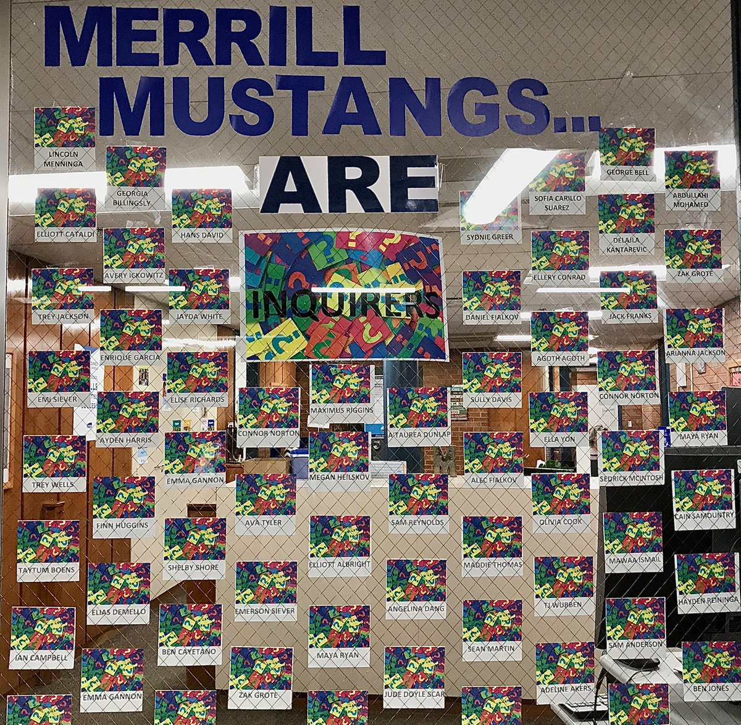
Celebrated

Slide 10
Your School Day
Starts at 8:30
Students are allowed into the building at 8am.
Students may go to the cafeteria for breakfast or go to the gym and wait to be dismissed at 8:20 to go to your lockers.
School is dismissed at 3:25

Slide 11
There are 7 periods in your day.
All students will take:
1. Language Arts
2. Math
3. Science
4. Social Studies
5. World Language (Spanish)
6. PE (every other day)
Music (opposite PE): Band, Orchestra, Vocal Music
7. Wheel Class: Business Tech…FACS…Art

Slide 12
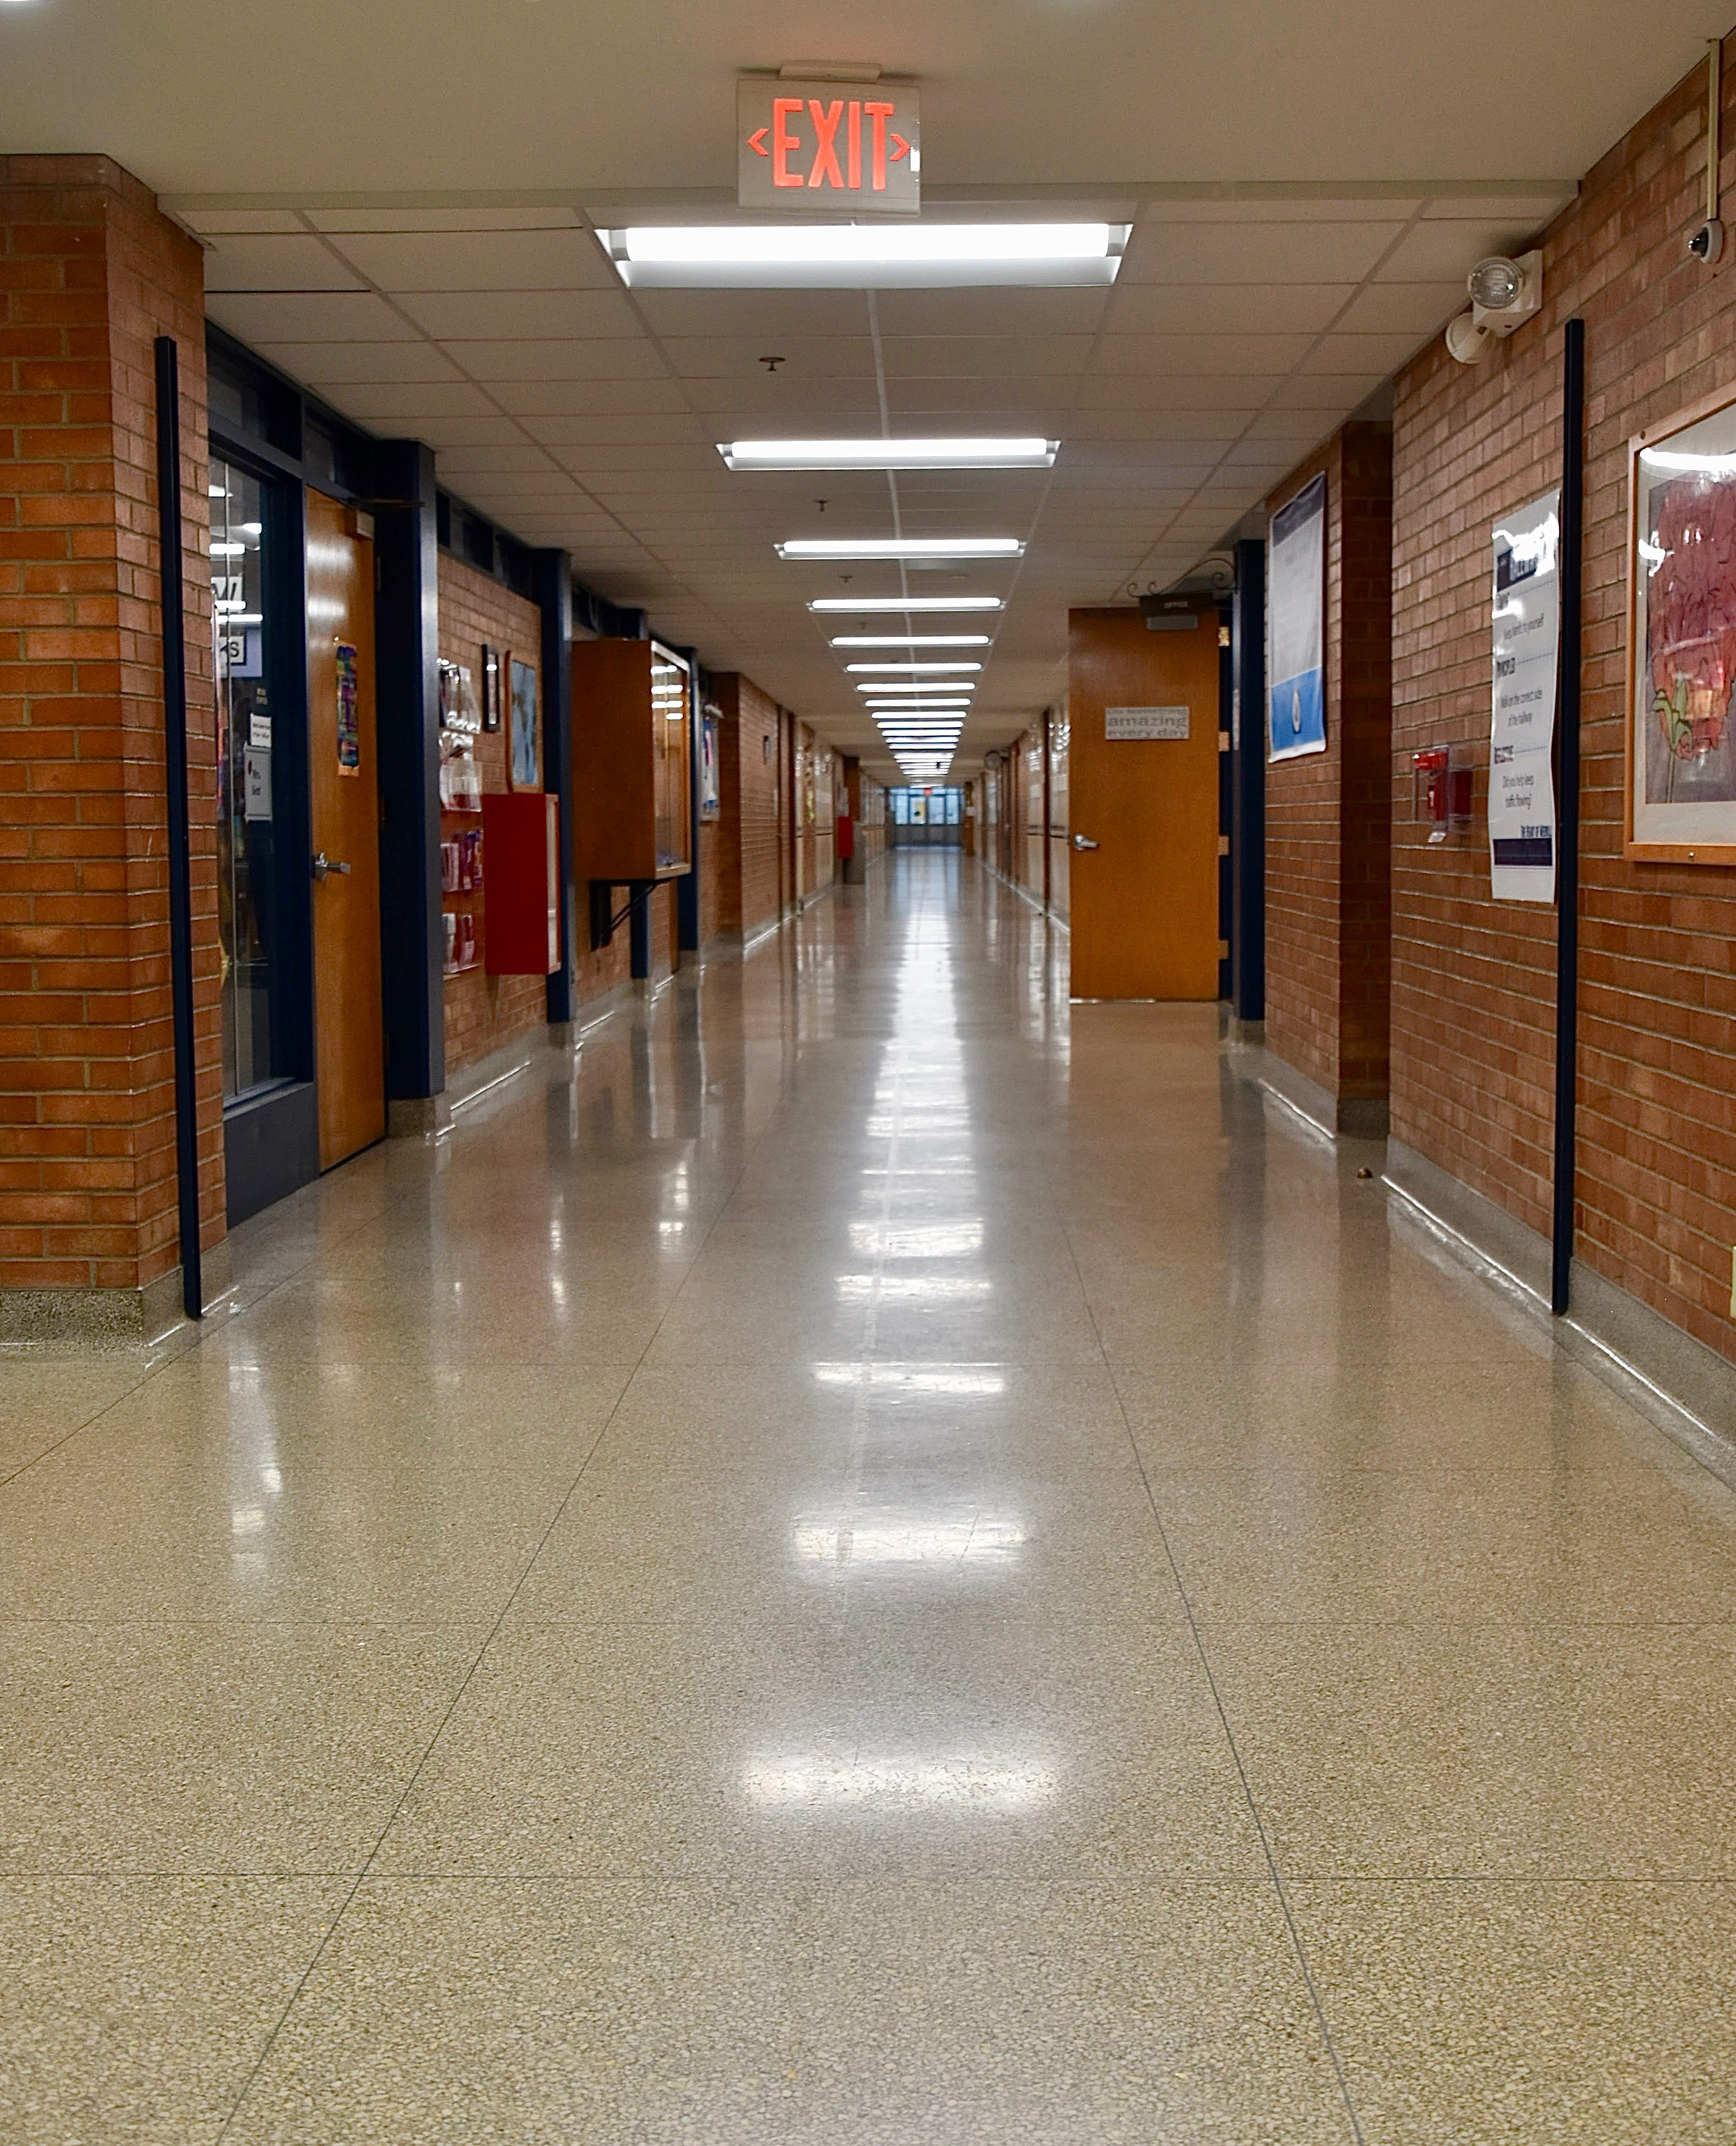
Most of your classes
will be in
Our 6th Grade Hallway.

Slide 13
Lockers……..
are on the 1st floor.
have a locker combination.
are assigned two students per locker.
are where students keep their backpack, books and cold lunch.

Slide 14
Reminder:
Do not give out your combination.
Don’t ask your friends for their combo.
Do not leave food or drink in your locker.
Leave valuables at home.
Clean out your locker on a regular basis.
Be considerate of your locker partner!

Slide 15
You will have an opportunity to practice opening your locker. We are here to help you!

Slide 16
PE
Everyone takes PE every other day.
No required PE clothes or assigned lockers.
No Showers

Slide 17
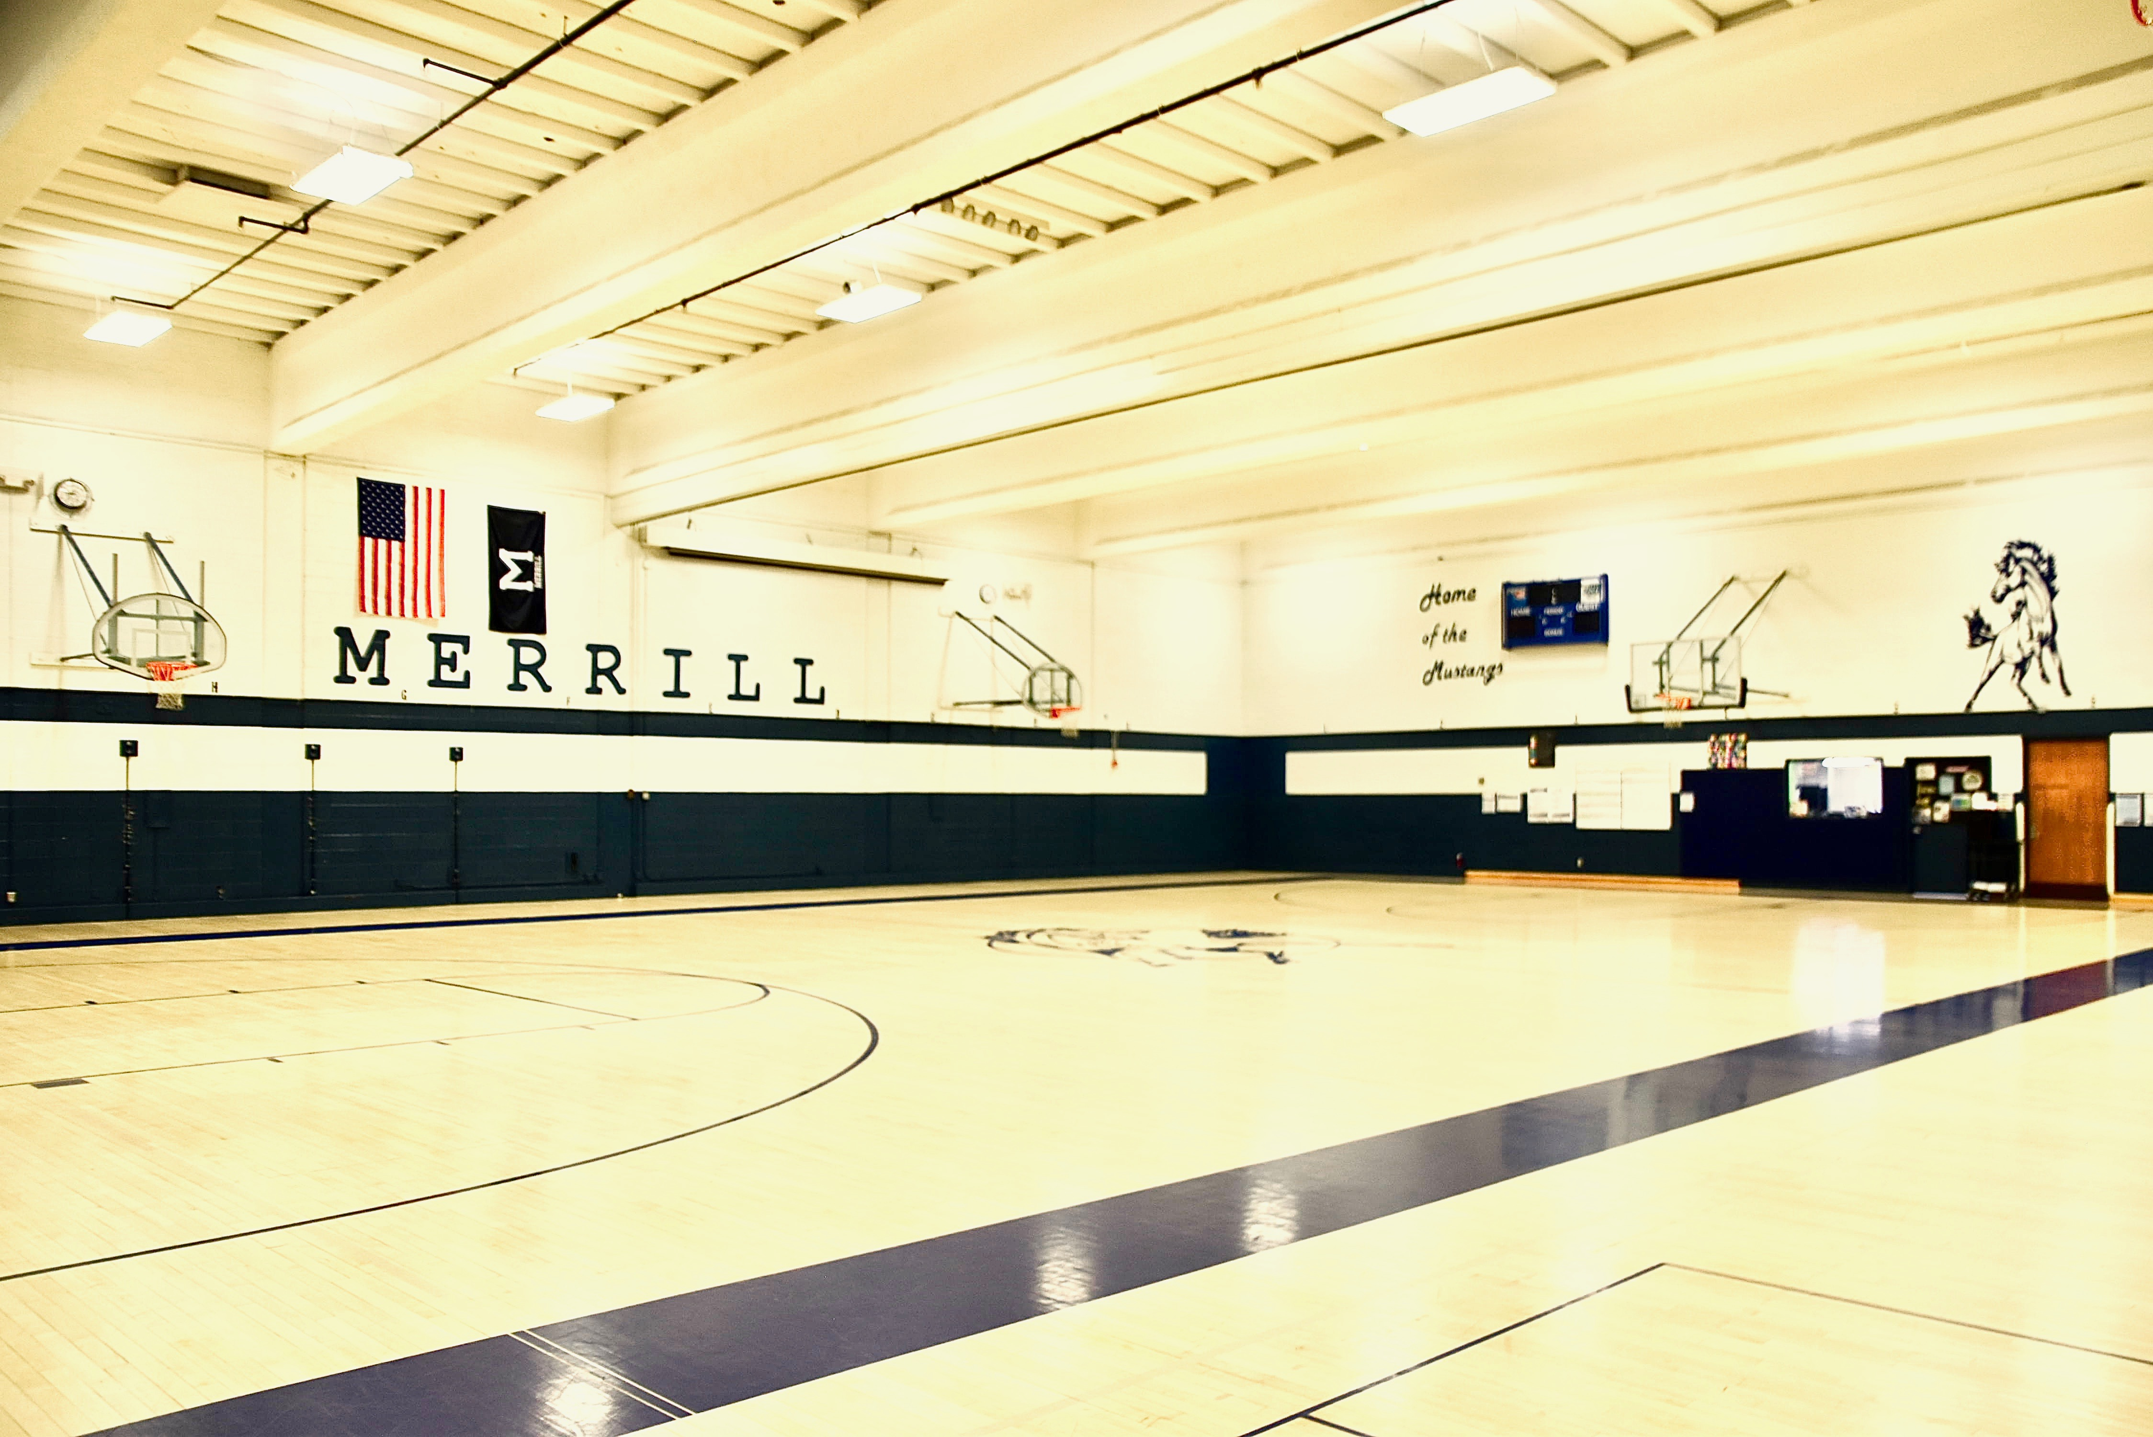

Slide 18
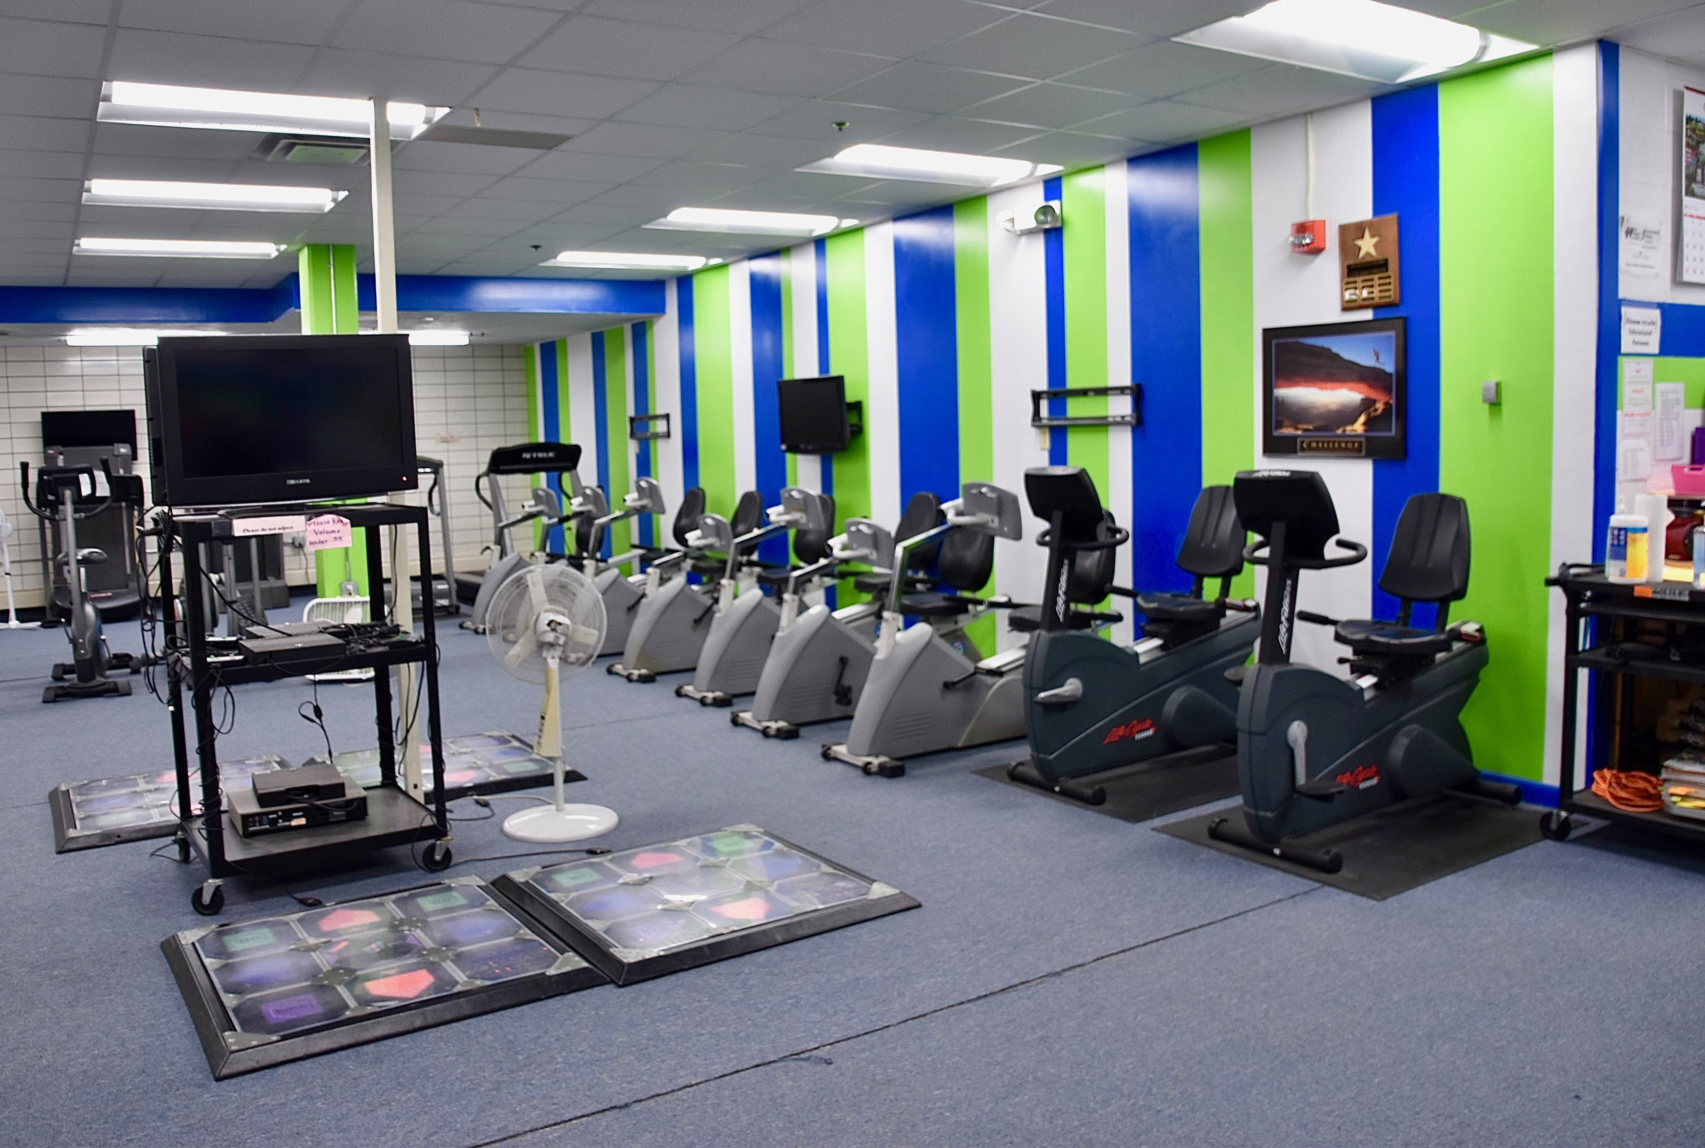

Slide 19
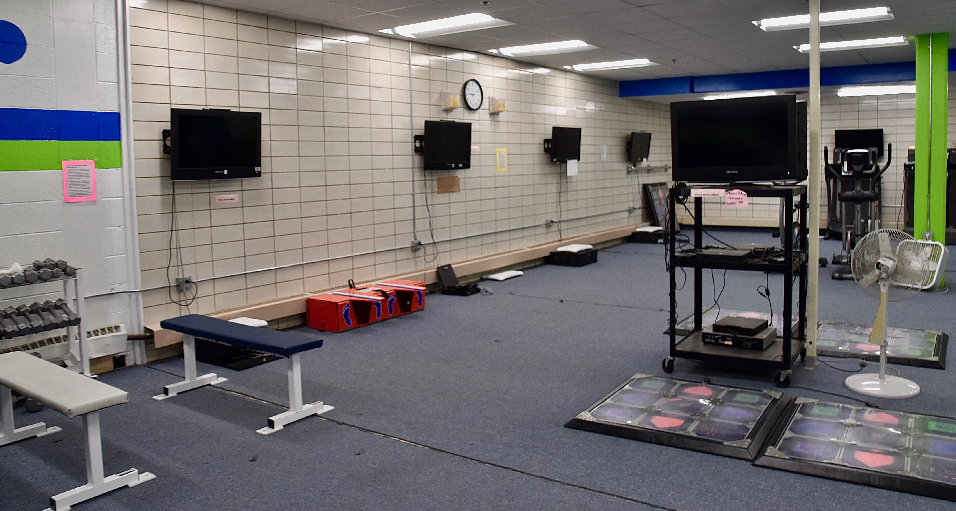

Slide 21
Activities/Clubs
Stay and Play
Kickball, Ultimate Frisbee, Floor Hockey, Basketball
Clubs
Harry Potter, Tik Tok, Sign Language, Sit and Knit,
Earth, Recycling, Bridge, Big Brothers/Big Sisters
Anime, Debate, Mock Trial, History, Coding,
Dream To Teach, Girls Voices and many more!!

Slide 22
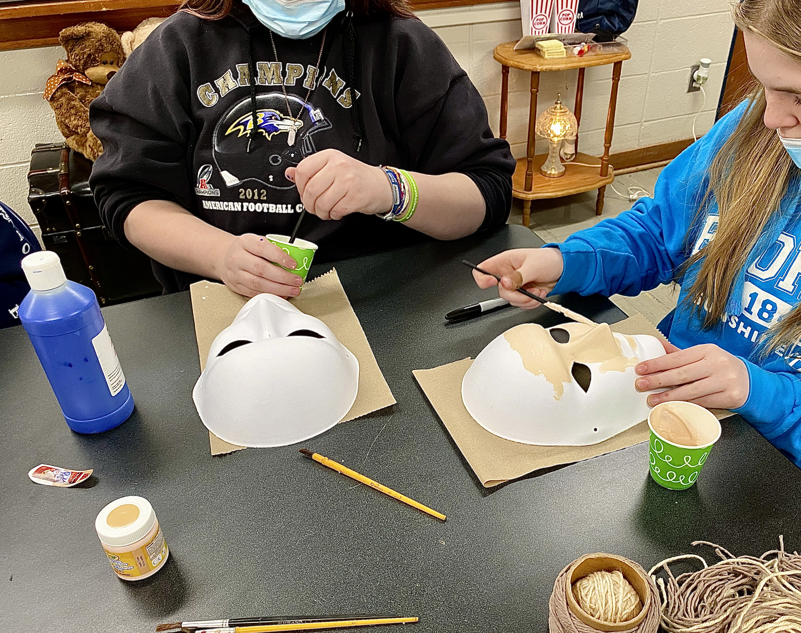
Clubs meet:
before school
during school
after school
Yes! You can join more than one club!

Slide 23
Cafeteria
You may sit where ever you like.
Can't save seats.
Can't own a seat.
Breakfast and lunch are free!
Same student lunch ID as last year....

Slide 24
Cafeteria
6th graders eat together
No assigned seating
Lunch # is your student ID
Hot Lunch = 3 choices
Cold Lunch = 2 choices
AlaCarte Items: chips, Rice Krispie
treats, drinks, beef jerky, gold fish, elf grahms, cereal bars...etc….
No Cell Phone: music and games
no social media or pic taking!

Slide 25
Will we have a homework?
That depends, you will be busy in class so being organized and managing your time will be very important. The more you accomplish is class, the less homework there is. Be sure to establish a positive class time routine early on. You will want to:
􏰀 Be on time to class so you don't miss important instructions at the beginning.
􏰀 Always come to class prepared with paper and something to write with.
􏰀 Ask questions if you don't understand something or need clarification. You can raise your hand or TEAMS message your teacher. You can also send your teacher an email.
􏰀 Focus on your classroom task first, prioritize. #YouGotThis!

Slide 26
Cell Phone
Policy
Must have teacher permission to use during class.
(ie: Kahoot)
Must be turned off and out of sight.
(please respect teacher discretion)

Slide 27
Hall Pass Name Date Time Where?

Slide 28
We are excited to have you join us!
Go Mustangs!

